Slide 1
Simulation_files_and_curves

Slide 2
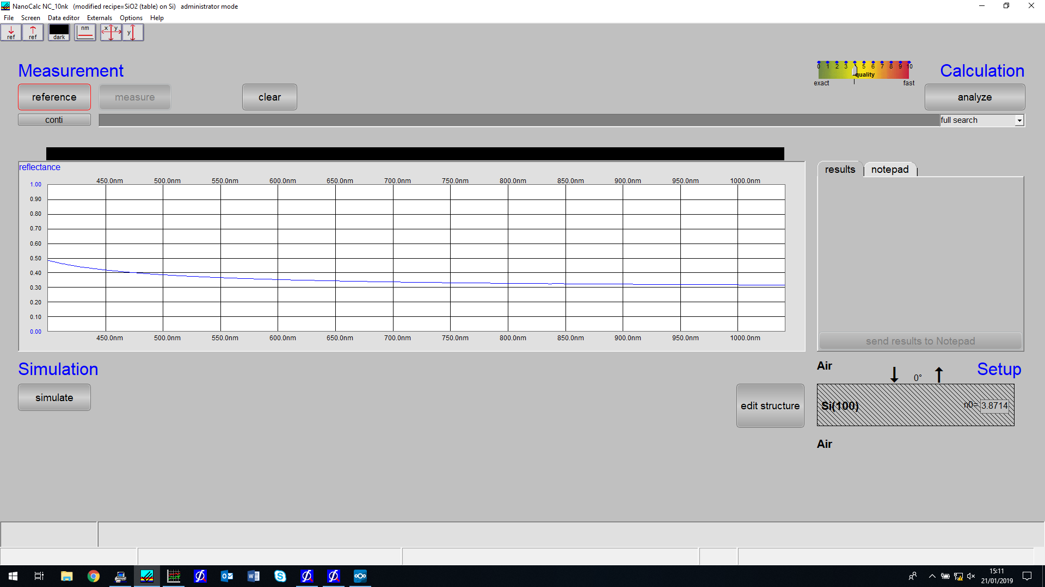
Filename: Air_SI(100)_Air.xy
Done – Air_SI_Air.m

Slide 3
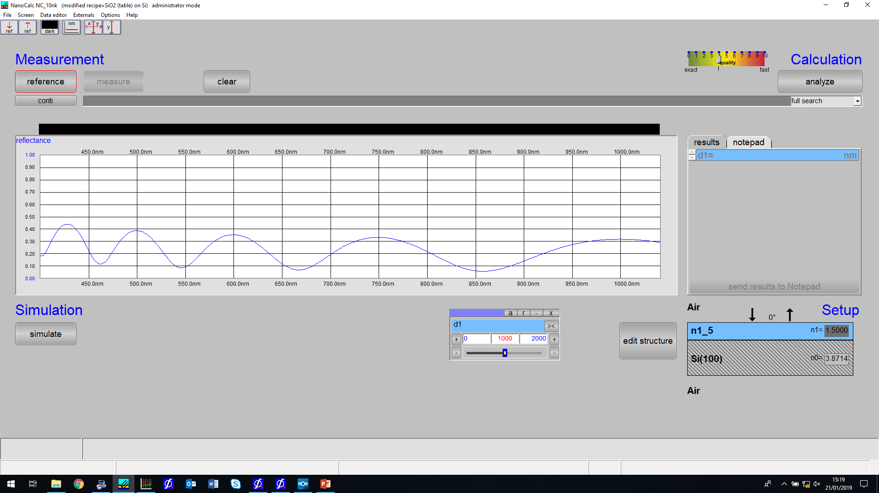
Air_n1_5_SI(100)_Air.xy
Done – Air_n1_5_SI_Air.m

Slide 4
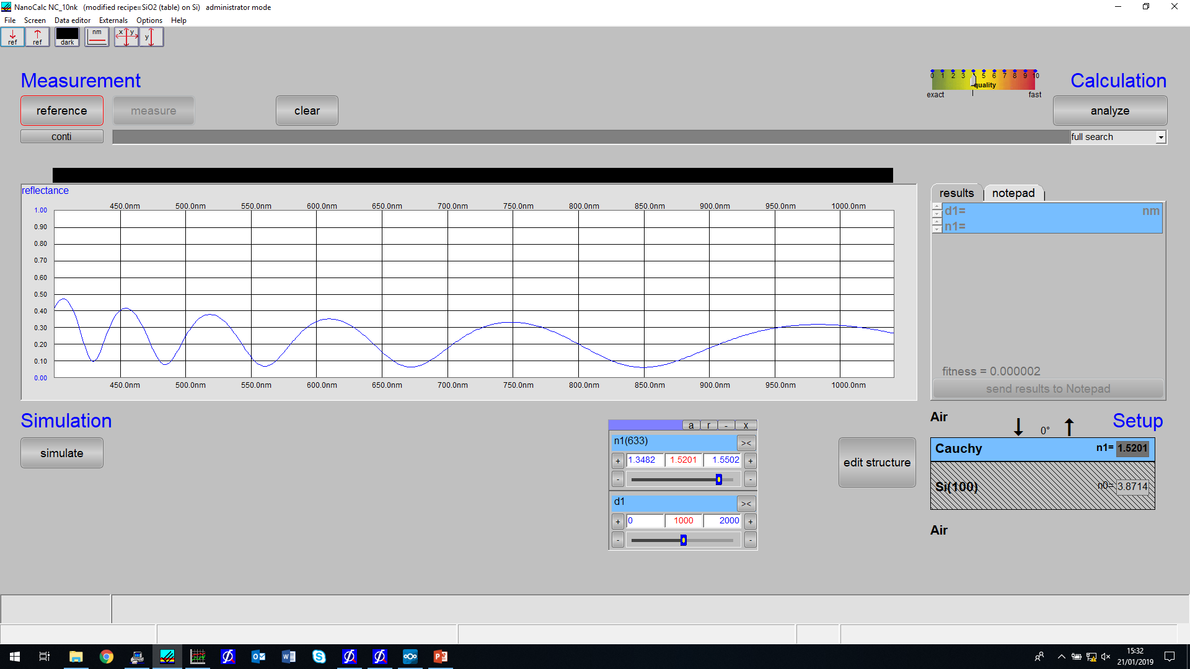
Air_Cauchy_SI(100)_Air.xy
Done - Air_Cauchy_SI_Air

Slide 5
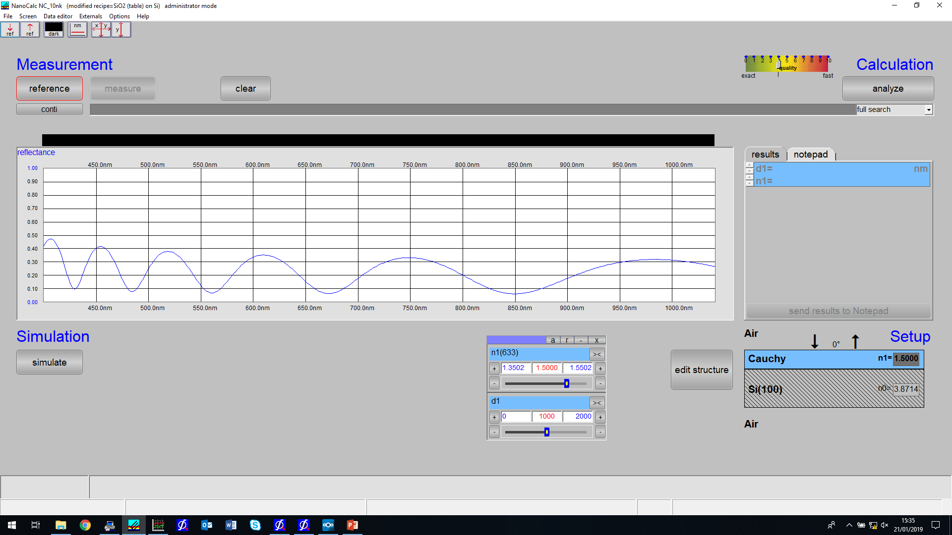
Air_Cauchy_SI(100)_Air2.xy

Slide 6
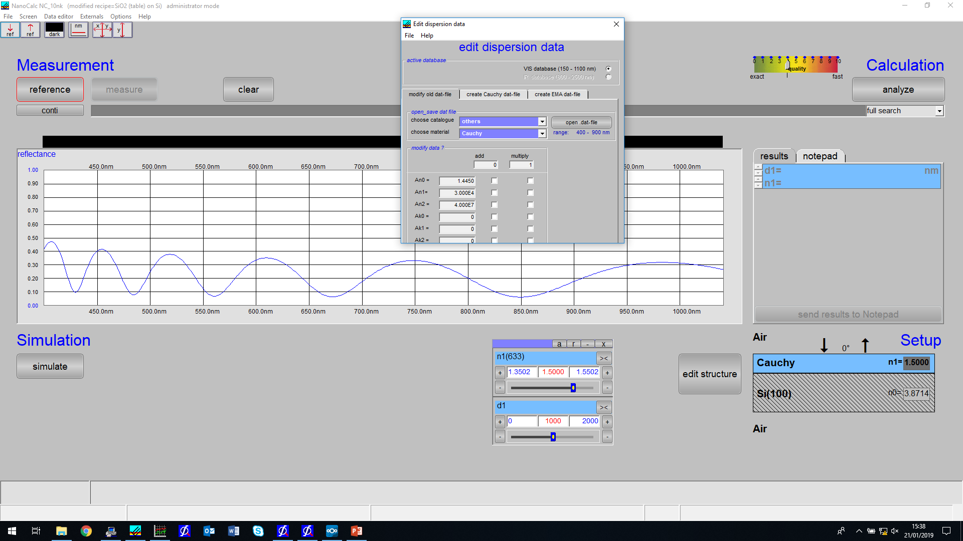
Cauchy coefficients for Air_Cauchy_SI(100)_Air2.xy
Done – Air_Cauchy_SI_Air2.m

Slide 7
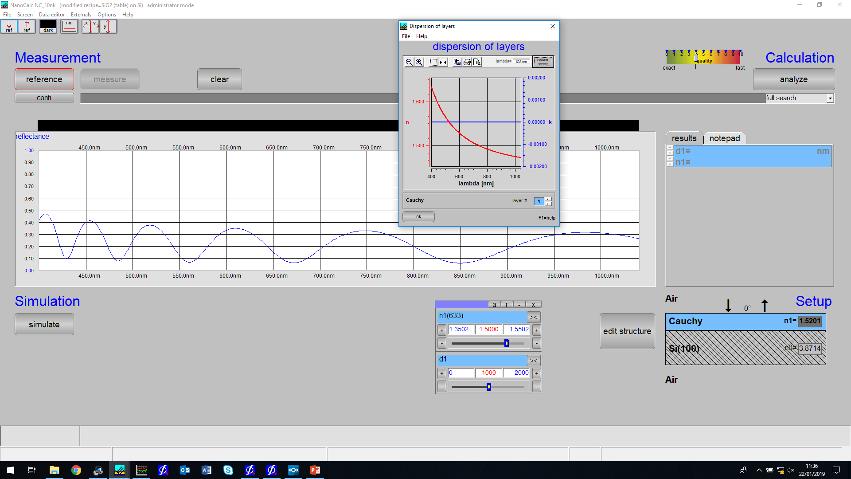

Slide 8
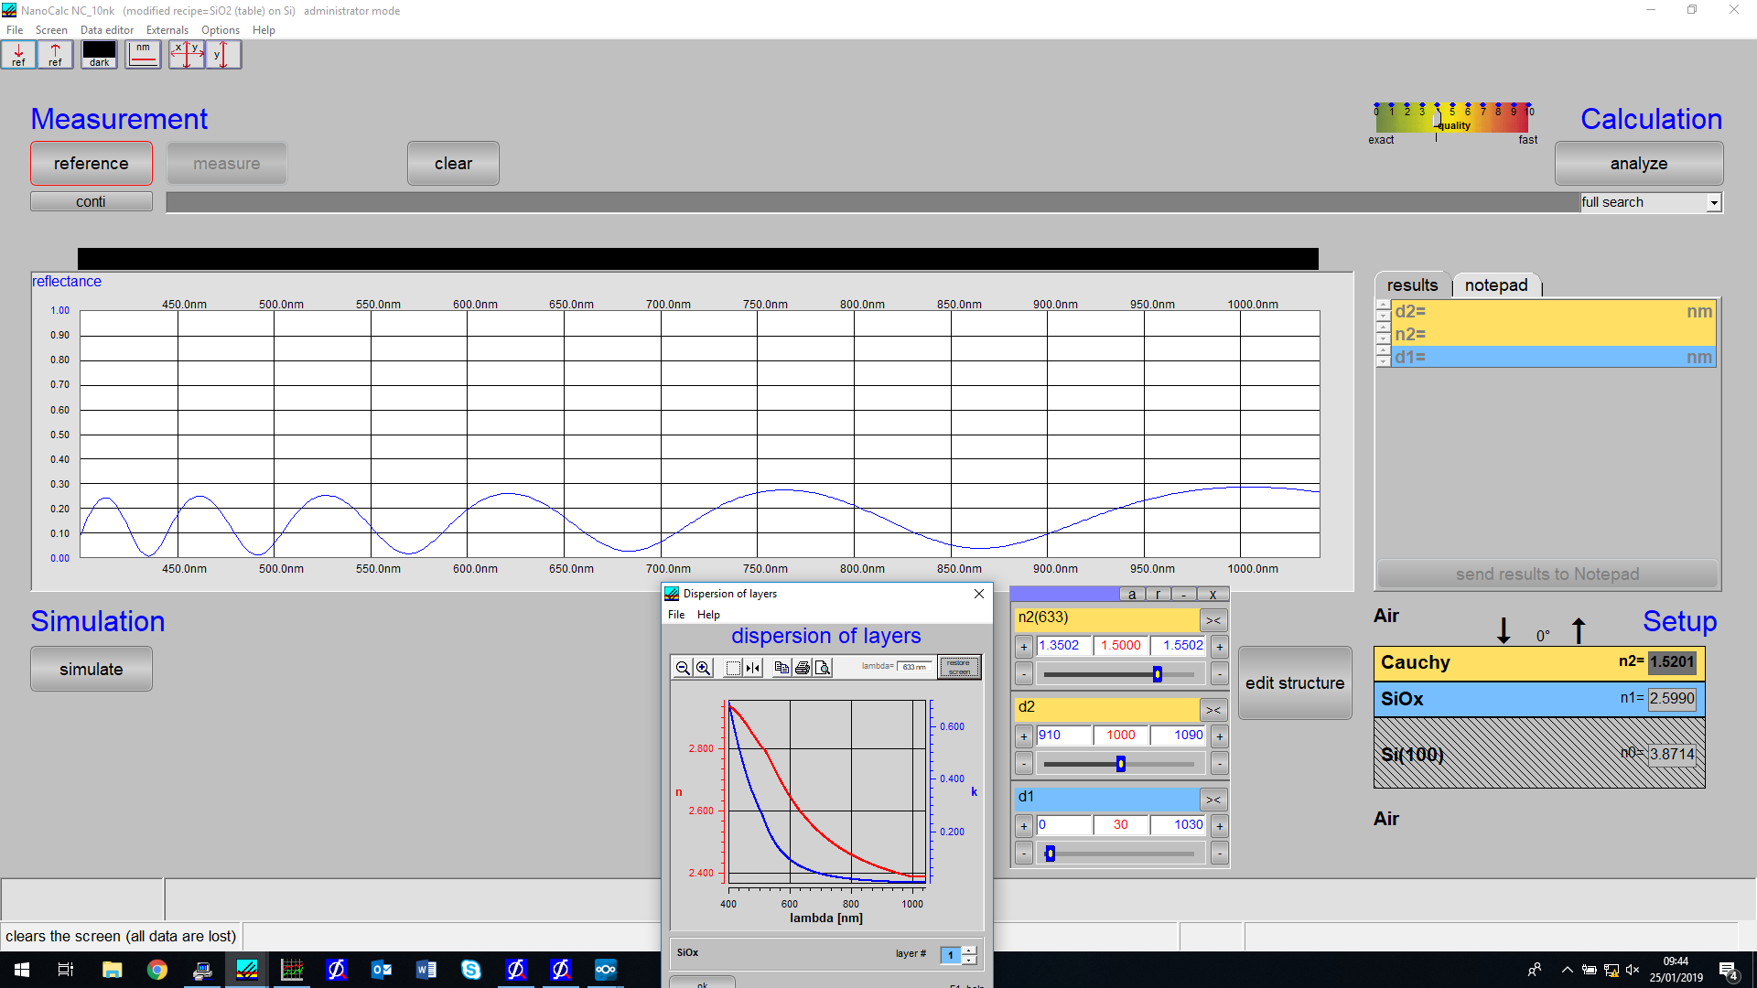
Filename: Air_Cauchy_SiOx_SI.xy

Slide 9
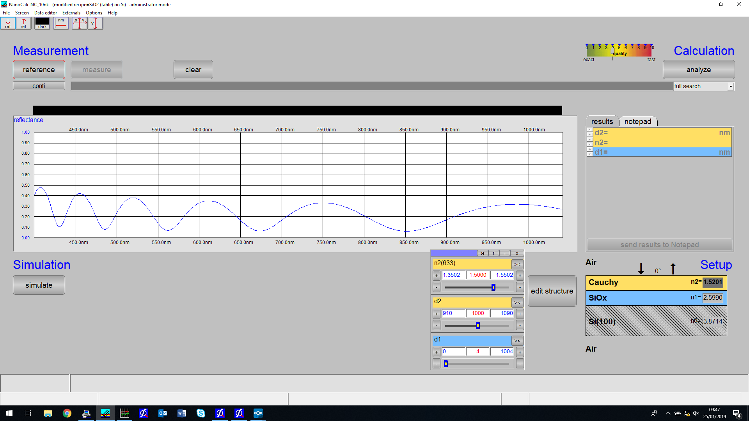
Filename: Air_Cauchy_SiOx(4nm)_Si.xy

Slide 10
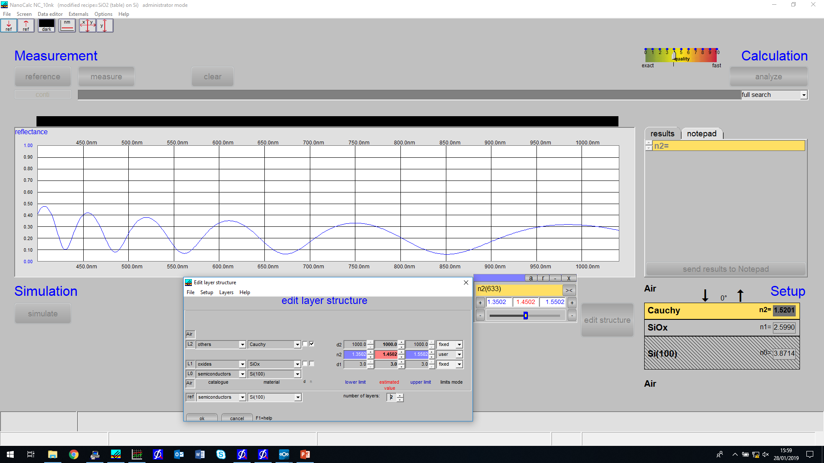
Filename: Air_Cauchy_SiOx(3nm)_Si.xy

Slide 11

Filename: Air_Cauchy_SiOx(2nm)_Si.xy

Slide 12
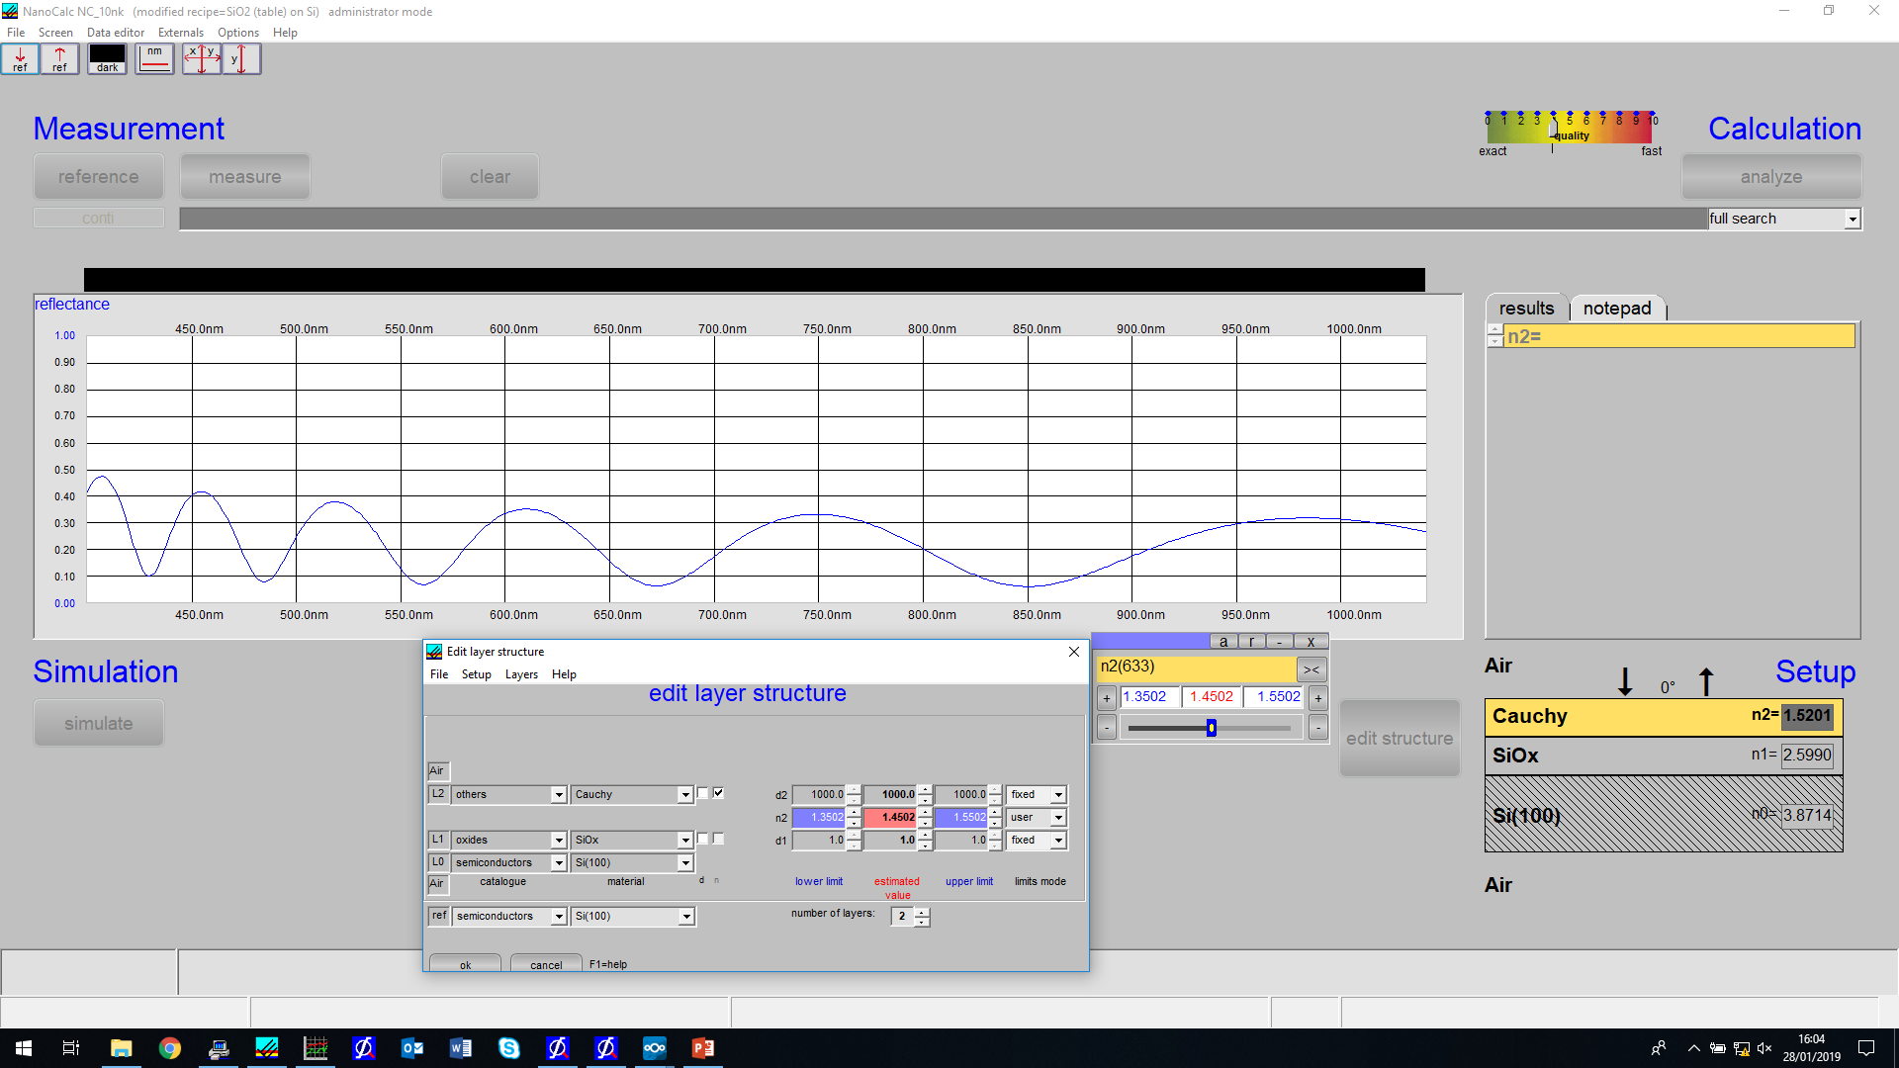
Filename: Air_Cauchy_SiOx(1nm)_Si.xy

Slide 13
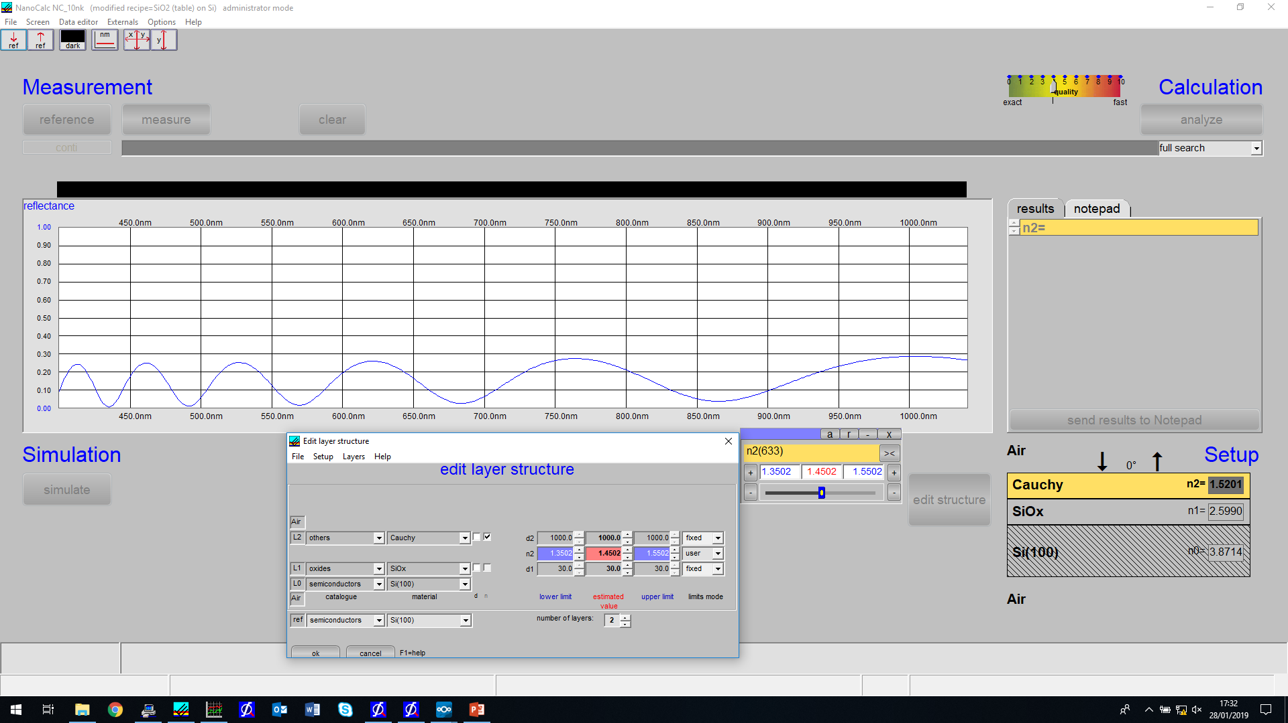
Filename: SiOx30nmtry.xy

